Slide 1
Mother and Baby homes
Junior Cycle History
Unit 1

Slide 2
Unit 1: Outline
Slide | Activity No | Activity Name | Description
3 | 1 | Coming to terms | Introduction to Ireland’s historic institutions and pre-teaching of relevant terminology (teacher input and pair work)
4 | 2 | Our Brave Space | Devising a Brave Space Agreement (pair and small group work, whole class discussion)
6-7 | 3 | Architecture of containment | Data relating to Ireland’s historic institutions (whole class discussion) | Introduction to the concept of the architecture of containment (teacher input)
8-10 | 4 | For much of the C20th… | Relevant articles from the 1937 constitution (whole class discussion) | Life for women and children in C20th Ireland (teacher input, small group work, whole class discussion)
11 | 5 | S.I.T. | Reflection (individual work)

Slide 3
Activity 1: Coming to terms
Industrial schools
Report of the Commission to inquire into child abuse (2009)
For ‘neglected, orphaned or abandoned’ children, including those born in Mother and Baby homes.
Focused on religious instruction and practical training (boys – farm workers; girls – domestic servants).
Often included for-profit enterprises, such as commercial farms, involving child labour.
Were run by religious orders; legislated for and inspected by the state, with public funding.
Magdalene Laundries
Report of the Inter-Departmental Committee to establish the facts of State involvement with the Magdalen Laundries (2013)
For girls/women who were perceived to be ‘promiscuous’, ‘unmarried’ mothers coming from Mother and Baby homes, the daughters of ‘unmarried’ mothers, those considered a burden on families or the state, those who had been sexually abused, or had grown up in industrial schools.
Were run by religious orders for profit, with public funding and dependent on the unpaid labour of girls/women.
Mother and Baby homes
Report of the Commission of Investigation into the Mother and Baby Homes (2021)
For girls/women who became pregnant outside of marriage.
Women were confined for varying periods of time after their baby was born, doing unpaid manual labour, such as cleaning, cooking, looking after children (not always their own). Some women were transferred directly from/to Magdalene Laundries. Children who did not leave with their mothers or die in the homes were, sometimes years later, boarded out (fostered), adopted (il/legally) or sent to industrial schools.
Were run by religious orders; legislated for and inspected by the state, with public funding.

Slide 4


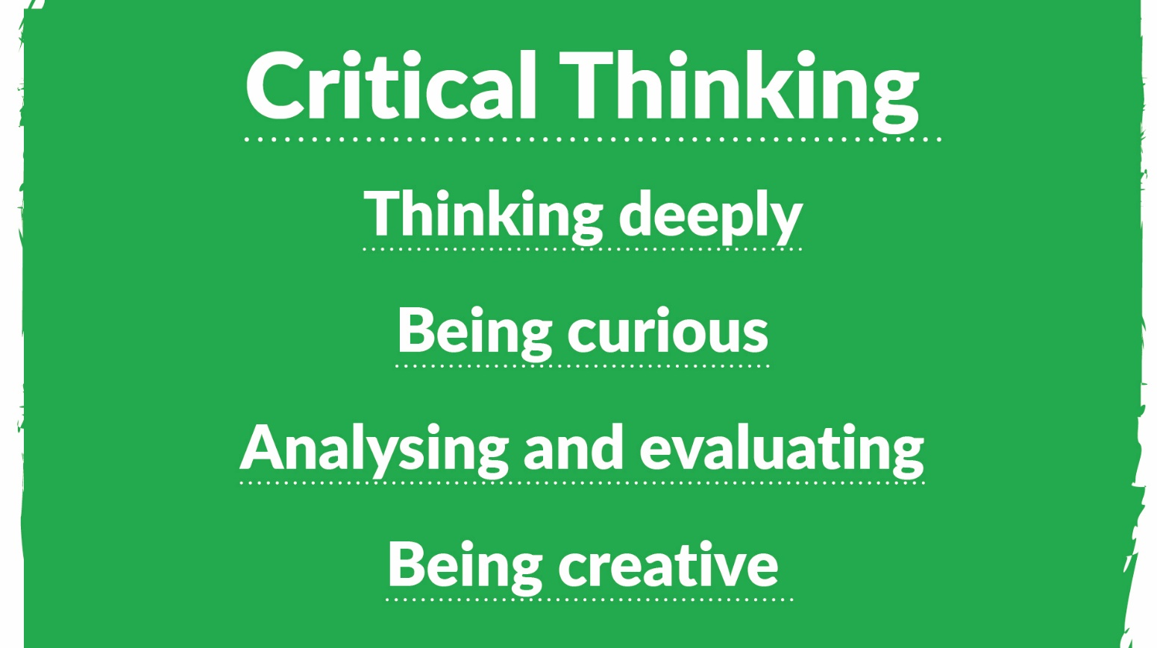
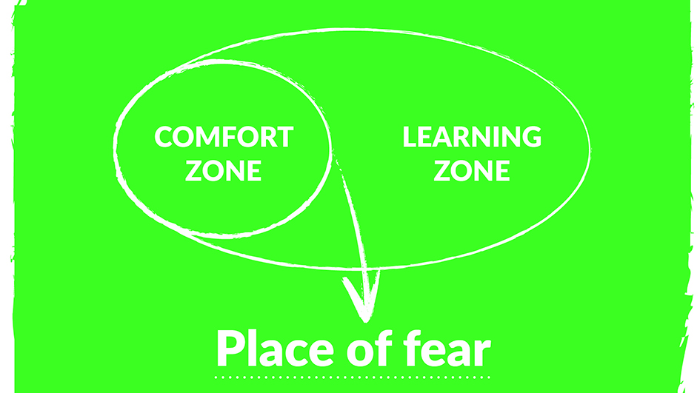


Activity 2: Our Brave Space
In our brave space we can do this by…

Slide 5
If you are affected by any of the issues in this unit, and need support, come to me after class, talk to a trusted friend or adult and/or contact:
Adoption Rights Alliance: www.facebook.com/AdoptionRightsAllianceIreland/
Barnardos Origins, Post Adoption and Bereavement Services: www.barnardos.ie
Samaritans: www.samaritans.org
Phone: 116 123
Childline: www.childline.ie
Phone: 1800 66 66 66
Jigsaw: www.jigsaw.ie

Slide 6






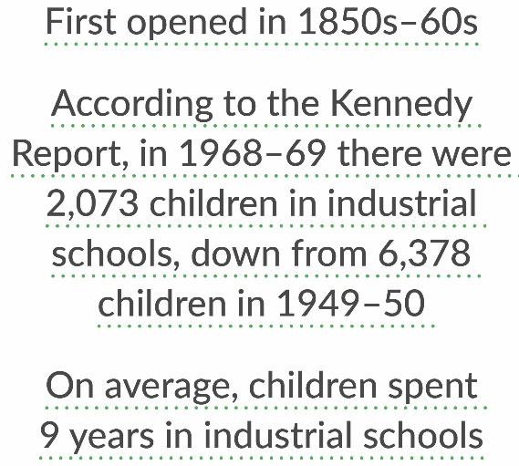
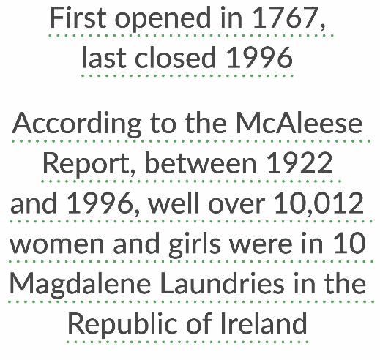
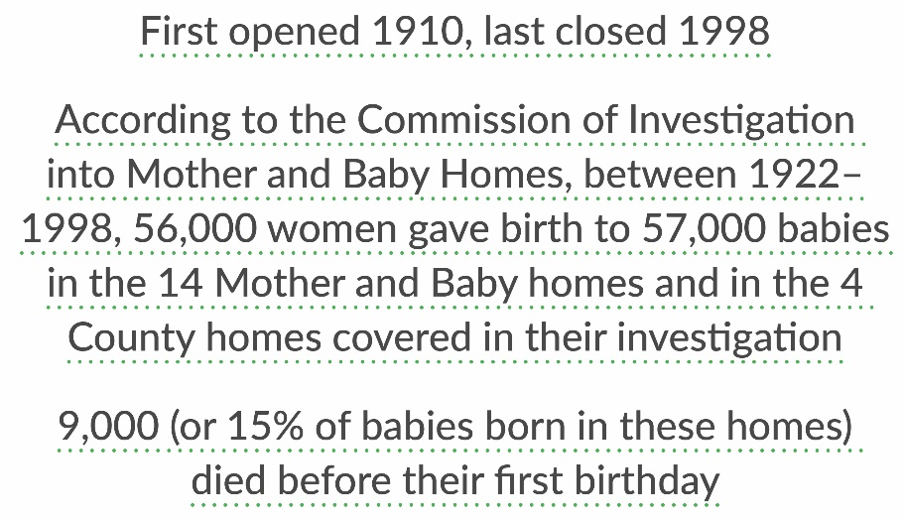


Slide 7
Activity 3: Architecture of containment
My name is Mary Harney. I am the proud daughter of Margaret ‘Peggy’ Harney. … I do not know much about my mother's early life other than that her mother died when she was 12 at which point she was sent to St Dominic's Industrial School where she stayed until she was 16. … I was born in Bessborough [Mother and Baby home] in 1949. My mother and I stayed together in the Mother and Baby Home for two and half years. …My mother chose to do some of the most menial tasks….like sluicing out the babies’ napkins…so that she could sneak in to see me and pick me up, because women were not allowed free access to their children at any time of the day.
I suffered whooping cough and measles while I was there, and therefore I was not eligible to be trafficked to America. Those were communicable diseases, and in getting children to America, they had to be free of such prior conditions. … My mother was given a half an hour’s notice to get me ready to have me taken from her. … I was illegally fostered [boarded out to] an elderly couple… Because of their neglect, and also because I was probably suffering from malnutrition, a neighbour called the authorities and I was taken from the foster parents in 1954. I was brought to the courthouse in Cork, and the judge sentenced me to twelve and a half years in the Good Shepherd Industrial School at Sunday’s Well in Cork City. …We were deprived of food if we disobeyed rules. We were always deprived of water… We were beaten… It was there that I learned how to begin to resist.
I am not a survivor. I am a small, yet mighty, resisting worker for justice.
Mary Harney, quoted in O’Donnell, K., O’Rourke, M. & Smith, J. eds. 2022. Redress: Ireland’s Institutions and Transitional Justice. UCD Press: Dublin. p.3-5; Mary Harney, CLANN witness statement.

Slide 8
Activity 4: For much of the C20th…
The family, women and children in the (1937) constitution (Bunreacht na hÉireann)
Article 41
1.1 – The State recognises the Family as the natural primary and fundamental unit group of Society, and as a moral institution possessing inalienable and imprescriptible rights, antecedent and superior to all positive law.
1.2 – The State, therefore, guarantees to protect the Family in its constitution and authority, as the necessary basis of social order and as indispensable to the welfare of the Nation and the State.
2.1 – In particular, the State recognises that by her life within the home, woman gives to the State a support without which the common good cannot be achieved.
2.2 – The State shall, therefore, endeavour to ensure that mothers shall not be obliged by economic necessity to engage in labour to the neglect of their duties in the home.
Article 42
5 – In exceptional cases, where the parents for physical or moral reasons fail in their duty towards their children, the State as guardian of the common good, by appropriate means shall endeavour to supply the place of the parents, but always with due regard for the natural and imprescriptible rights of the child.

Slide 9
Activity 4: For much of the C20th…
Very high levels of religious observance – mass attendance, pilgrimages, devotions and missions
An emphasis on the need for high ideals and moral virtue, especially for young women
Sex before marriage and adultery were considered sinful
There was no sex education, and most schools were under the control of the Catholic Church
Use of artificial birth control was forbidden by the Catholic Church and banned in law
Women who had children outside of marriage (labelled ‘fallen women’ or ‘unmarried mothers’) were stigmatised
Children born outside of marriage (labelled ‘illegitimate’), were judged for bearing the sins of their mothers
Corporal punishment was accepted
Divorce was illegal
Censorship (banning) of literature, especially relating to sexuality or reproduction
Dances could only be organised with permission from clergy, gardai and the judiciary
Barriers to women sitting on juries
Women working in the Civil/Public Service had to resign when they married
The government could control and restrict the numbers of women working in any industry to lessen male unemployment

Slide 10
Activity 4: For much of the C20th…
…there was a woman in the parish. And she would have been the one to go down to the priest if she got any news… So she found out that my mother was pregnant, … and she told the priest... So straight way then the priest came to the house. And of course, her parents were nervous and afraid to see a priest coming and the whole lot. So, he took control of everything altogether. He said that … she was barred from the church because she was a sinner. And…she was to be kept indoors because it would be a bad influence on all the kids around to see her pregnant. It wasn’t good. And they told her that there was a place in Tuam … that, when she was due to have the baby she would be taken to Tuam and the nuns would look after her down there. Of course, it was an awful embarrassment to her mother and father and – of course neighbours around and the chatting going around and all that. The gossip back in them days. So anyway, eventually she was brought to Tuam by her father…
So, I was born on the 29th of the 11th ‘51...
For a photograph of Eileen and P.J. Haverty (1976) see University of Galway, Asset Id 13750, Archival Record Id TOHP, https://digital.library.universityofgalway.ie/p/ms/asset/13750
Transcript of interview with P.J. Haverty, University of Galway, Asset Id 13756, Archival Record Id TOHP, https://digital.library.universityofgalway.ie/p/ms/asset/13756

Slide 11
Activity 5: S-I-T
One Surprising fact or idea
One Interesting fact or idea
One Troubling fact or idea

