Slide 1
Mother and Baby homes
Junior Cycle History
Unit 2

Slide 2
Unit 2: Outline
Slide | Activity No | Activity Name | Description
3 | 1 | Revisiting our Brave Space | Devising a question for a classmate about the Brave Space Agreement (individual work)
4 | 2 | Picturing a home | Picturing the Tuam Mother and Baby home based on historical descriptions (individual work)
5 | 3 | Timeline of a home* | Human timeline of the Tuam home (individual work, small group work)
6 | 4 | Connections to home* | Identifying people/groups that lived in or were connected to the Tuam home (small group work)
7 | 5 | Responsibility | Responsibility for Mother and Baby homes (whole class discussion)
8 | 6 | Mapping the homes | Locating Mother and Baby homes (teacher input and demonstration, pair work) NB: Internet access required here
10 | 7 | Pause | Reflection (individual work)
* See ‘JC History Unit 2_Activities 3 & 4_Timeline cards.pdf’
Teacher preparation required

Slide 3
Activity 1: Revisiting our Brave Space
Read our Brave Space Agreement
Focus on one part of the Agreement
Come up with one question for a friend asking whether they are living up to this part of the Agreement
Write your question on a piece of paper
Swap your question with a friend to be answered at the end of this unit

Slide 4

Activity 2: Picturing a home
A big open space and big grey stone walls. Each side of it was a three-storey building with a two-storey building in between, beautifully built walls like the Cathedral [in Tuam], cut stone, cold looking but beautifully built.
Julia Carter, who worked as a servant/gardener in the Mother and Baby home in Tuam
The mother and baby home was a strange place. It was a huge building, much bigger than anything else in Tuam, apart from the cathedral.’ There were ‘glass shards embedded in the top’ of the ‘high stone wall’ surrounding the home.
Catherine Corless, local historian and activist
The building, though spacious, was - like all such Institutional structures - primitive and irregularly spread out, in spite of the various renovations and improvements that had been made.
Bon Secours nun
For copyright reasons the photograph of the scale model of the Tuam home cannot be displayed in this editable version of the slides.
Instead, consider searching for an old photograph of the home online.

Slide 5
Activity 3: Timeline of a home
Part 1
Read through your card and identify any words or phrases you don’t understand. Ask a friend for help. If that doesn’t work, ask me.
Part 2
Create a timeline of the Tuam home, physically ordering yourselves from earliest to most recent year.
I will divide you into small groups
Part 3
In your group, plan and make a presentation about the events/personalities on your combined timeline cards.
Group presentations will be in chronological order (from the earliest to most recent years)

Slide 6
Activity 4: Connections to home
Who? | How were they involved/connected?
Staff at Central Hospital, Galway city | Between 1925-35 (before the Tuam home got its’ own maternity unit) children were born in Central Hospital in Galway city and then transferred to the Mother and Baby home in Tuam.
Grandparents of children in the home | A local doctor claimed that Galway County Council (local government authority) collected payments from some parents of mothers in the Tuam home (1957)
Workers from outside the home | For example, the people who installed the electric lighting in 1927 and those that demolished the building in 1971
… | …
… | …
… | …
… | …
… | …
… | …

Slide 7
Activity 5: Responsibility
…It is easy, but not very accurate, to dismiss what happened in child care in the past as belonging to a past that has nothing to do with us; to demonise individual nuns and clerics or whole religious orders and blame ‘the Church’ for what happened; to distance ourselves from it and exonerate ourselves. What happened was the collective responsibility of society.
Sister Stanislaus Kennedy, social worker, activist and writer
Church and State colluded to write the constitution, the contract by which every citizen in society is bound. Therefore responsibility … lies with the Church and State regime, and not the Irish people. … We, as a society, were coercively controlled by Church and State to behave in ways that were contrary to our nature.
Laura Murphy, daughter of a Mother and Baby home survivor

Slide 8
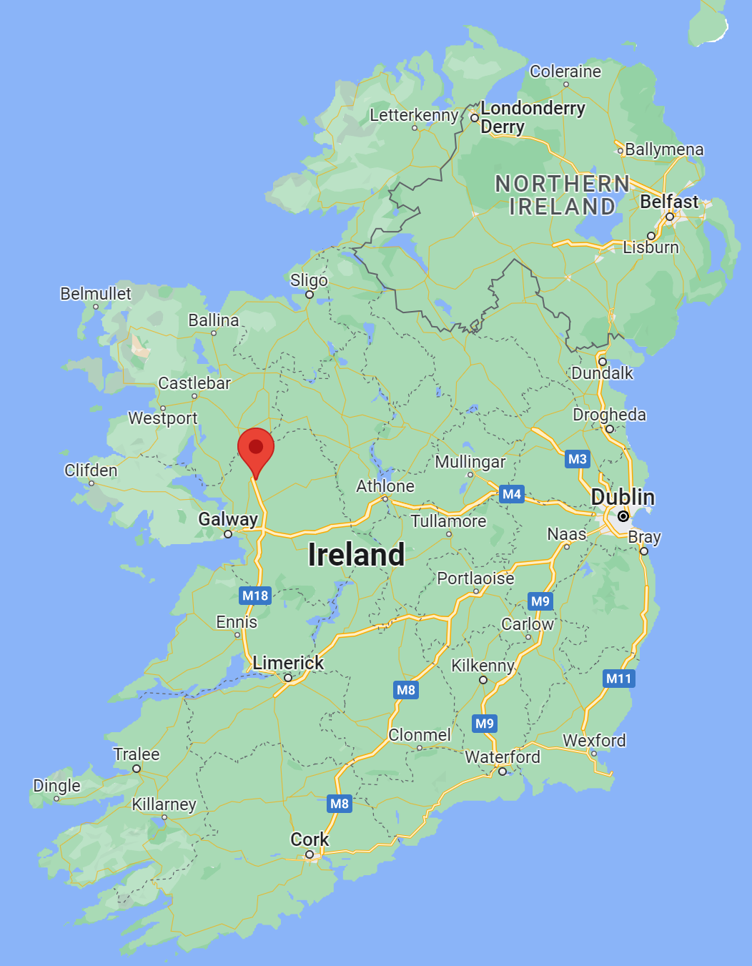
Activity 6: Mapping the homes
Ard Mhuire - Dunboyne, Co Meath
Belmont (Flatlets) - Belmont Ave, Dublin 4
Bessboro House - Blackrock, Cork
Bethany home* - originally Blackhall Place, Dublin 7, later Orwell Road, Rathgar, Dublin 6
Denny House - originally 8 Lower Leeson St, Dublin 2, later Eglinton Rd, Dublin 4
Kilrush - Cooraclare Rd, Co Clare
Manor House - Castlepollard, Co Westmeath
Ms. Carr’s (Flatlets) - 16 Northbrook Rd, Dublin 6
Regina Coeli Hostel - North Brunswick Street, Dublin 7
Sean Ross Abbey - Roscrea, Co Tipperary
St. Gerard’s - originally 39, Mountjoy Square, Dublin 1
St. Patrick’s - originally Pelletstown, Navan Road, Dublin 7, later Eglinton House, Eglinton Rd, Dublin 4
The Castle - Newtowncunningham, Co. Donegal
Mother and Baby home, Tuam, Co Galway

Slide 9
If you are affected by any of the issues in this unit, and need support, come to me after class, talk to a trusted friend or adult and/or contact:
Adoption Rights Alliance: www.facebook.com/AdoptionRightsAllianceIreland/
Barnardos Origins, Post Adoption and Bereavement Services: www.barnardos.ie
Samaritans: www.samaritans.org
Phone: 116 123
Childline: www.childline.ie
Phone: 1800 66 66 66
Jigsaw: www.jigsaw.ie

Slide 10

Activity 7: Pause
BRAVE SPACE AGREEMENT QUESTION
The pause button is made up of a circle with two inside rectangles.
Take a piece of paper, turn it so that it is orientated in landscape
(like this slide).
Copy the outline of the pause button, making it as large as possible on your page.
Imagine that the space inside the circle encompasses everything that you have learned in this unit. Write or draw your learning in this space.
Use the two rectangles in the centre of your pause button to write down the two most important things you will take away from the unit.

