Slide 1
Mother and Baby homes
Junior Cycle History
Unit 4

Slide 2
Unit 4: Outline
Slide | Activity No | Activity Name | Description
3 | 1 | Primary sources | Characteristics of primary sources (teacher input, whole class discussion)
4 | 2 | The job of the historian | How historian Catherine Corless used primary sources (individual work, teacher input) NB: Internet access required here
5 | 3 | Marian Bridget Mulryan | Document study of a child who died in the Tuam home (pair work, small group work, teacher input) NB: Internet access required here
7 | 4 | Secondary sources | Characteristics of secondary sources, using the work of Catherine Corless as an example (pair work)
8 | 5 | Options | Options for the burial site in Tuam (teacher input, small group work)
9 | 6 | Statement | Bon Secours and government apologies (small group work, teacher input)
10 | 7 | A wider Brave Space | A Brave Space Agreement to deal with the legacy of the architecture of containment (whole class discussion)
11 | 8 | Coping and resilience | Document study to show how one survivor copes (pair work, small group work)
13 | 9 | Timeline of learning | Reflection (teacher input, individual work)

Slide 3
Activity 1: Primary sources
are created by the witness who experiences the event or process, and often reflect the individual opinion of the participant or witness involved
provide the most fundamental information on the event/process under study and so are the raw materials that historians work with when they are interpretating people, events and/or processes and drawing conclusions about the past
are the original material on which secondary sources are based
can be in original format (e.g. handwritten letters), microfilm, digital/electronic or in published [printed] form
can be found in 3 different types of sources: official records; published sources; private sources

Slide 4

Activity 2: The job of the historian
“Tuam and Ireland’s shame: unedited interview with Catherine Corless”
As the video plays, listen out for the answers to these questions:
Which people and organisations did Catherine Corless approach when she was looking for evidence about the deaths and burials of the children in Tuam Mother and Baby home?
What primary sources did she find?
What information was available in these primary sources?
What conclusions did she come to?
What did Catherine Corless do to make sure that her conclusions were as sound as possible?
Pair up and compare answers.
Take note of any additional information that your partner has.
Play from start to 12.00mins

Slide 5
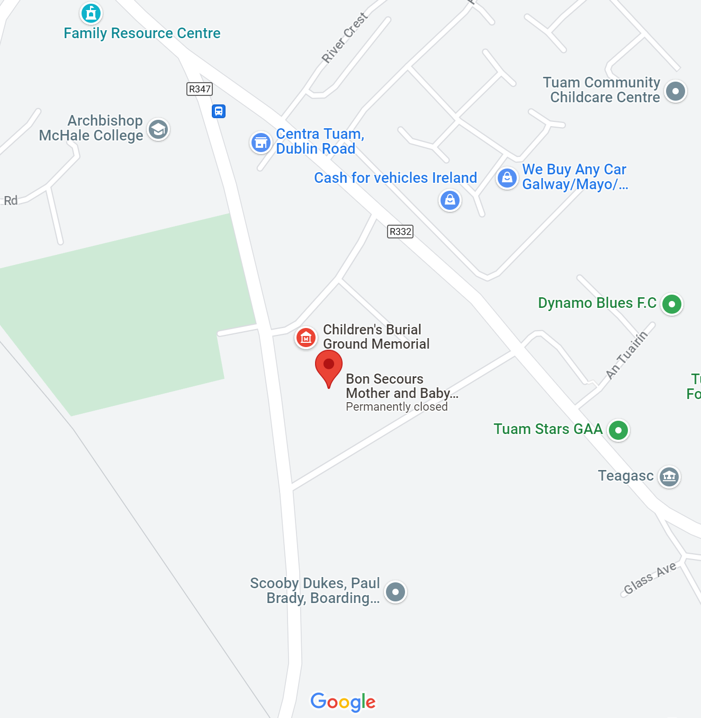
Activity 3: Marian Bridget Mulryan
See Document 2 - Birth Certificate for Marian Bridget Mulryan, University of Galway, Asset Id 13674, Archival Record Id TOHP, https://digital.library.universityofgalway.ie/p/ms/asset/13674

Slide 6
Names of the 796 children certified to have died at the Tuam Mother and Baby home between 1925-1960
Play from start to 5.08 mins

Slide 7
Activity 4: Secondary sources
For copyright reasons the image of the cover of Belonging cannot be displayed in this editable version of the slides.
Instead, consider searching for the image online.
present historical evidence
provide an interpretation of that evidence
draws conclusions about the people/event/process reported in the primary source(s).
A secondary source is always one step removed from the event/process under study.
The purpose of the secondary source is to persuade the reader to adopt a point of view.
When reading a secondary source, watch for the way that the writer presents their analysis and interpretation.
Catherine Corless’ memoir, Belonging, is about the Tuam home and her work as a historian.
Is Belonging an example of a primary or a secondary source? Explain your answer.

Slide 8

Activity 5: Options
Memorialisation
Exhumation of known human remains
Forensic excavation and recovery of known human remains
Forensic excavation and recovery of known human remains with further evaluation and excavation of other areas of interest
Forensic excavation of the total available area, removal and identification of human remains.
Listen to clip from “They’ll even come after your soul”
Episode 2, Tuam Oral History podcast, from 20.59-22.25 mins.

Slide 9
Activity 6: Statement
Statement of the Sisters of Bon Secours upon publication of the
Report of the Commission of Investigation into Mother and Baby Homes
The Commission’s report presents a history of our country in which many women and children were rejected, silenced and excluded; in which they were subjected to hardship; and in which their inherent human dignity was disrespected, in life and in death.
Our Sisters of Bon Secours were part of this sorrowful history.
Our Sisters ran [the] Mother and Baby Home in Tuam from 1925 to 1961. We did not live up to our Christianity when running the Home. We failed to respect the inherent dignity of the women and children who came to the Home. We failed to offer them the compassion that they so badly needed. We were part of the system in which they suffered hardship, loneliness and terrible hurt. We acknowledge in particular that infants and children who died at the Home were buried in a disrespectful and unacceptable way. For all that, we are deeply sorry.
We offer our profound apologies to all the women and children of [the Tuam] Mother and Baby Home, to their families and to the people of this country.
Healing is not possible until what happened is acknowledged. We hope and we pray that healing will come to all those affected; those who are living and those who have died. We hope that we, our church and our country can learn from this history.

Slide 10
Activity 7: A wider Brave Space
Read our Brave Space Agreement
Do we need a Brave Space Agreement in Ireland to help us come to terms with the legacy of our historic institutions, including Mother and Baby homes?
What would need to be deleted / added / changed to widen our Brave Space Agreement for this purpose?

Slide 11

Activity 8: Coping and resilience
For a photograph of Peter Mulryan with Handball Players see University of Galway, Asset Id 13665, Archival Record Id TOHP, https://digital.library.universityofgalway.ie/p/ms/asset/13665
“…go out and hit a ball against a wall and release the stress that is there in your head.”
Peter Mulryan

Slide 12
If you are affected by any of the issues in this unit, and need support, come to me after class, talk to a trusted friend or adult and/or contact:
Adoption Rights Alliance: www.facebook.com/AdoptionRightsAllianceIreland/
Barnardos Origins, Post Adoption and Bereavement Services: www.barnardos.ie
Samaritans: www.samaritans.org
Phone: 116 123
Childline: www.childline.ie
Phone: 1800 66 66 66
Jigsaw: www.jigsaw.ie

Slide 13
Activity 9: Timeline of learning
Before
Unit 1
Unit 2
Unit 3
Unit 4
Now
BEFORE: Use the rectangular space to write down what you knew about Ireland’s historic institutions, and especially the Mother and Baby home in Tuam, before doing these units.
UNITS 1-4: Use the circular spaces to record your significant learning in Unit 1, 2, 3 and 4 (things you found out that you didn’t know before, skills you gained or practiced, the main challenges you encountered and why these were challenging for you).
NOW: Use the rectangular space to note any questions you are left with, anything that you want to know more about and what you will now do to get answers or information.

