Slide 1

Mother and Baby homes
Junior Cycle History:
Suggested Classroom-Based Assessments

Slide 2
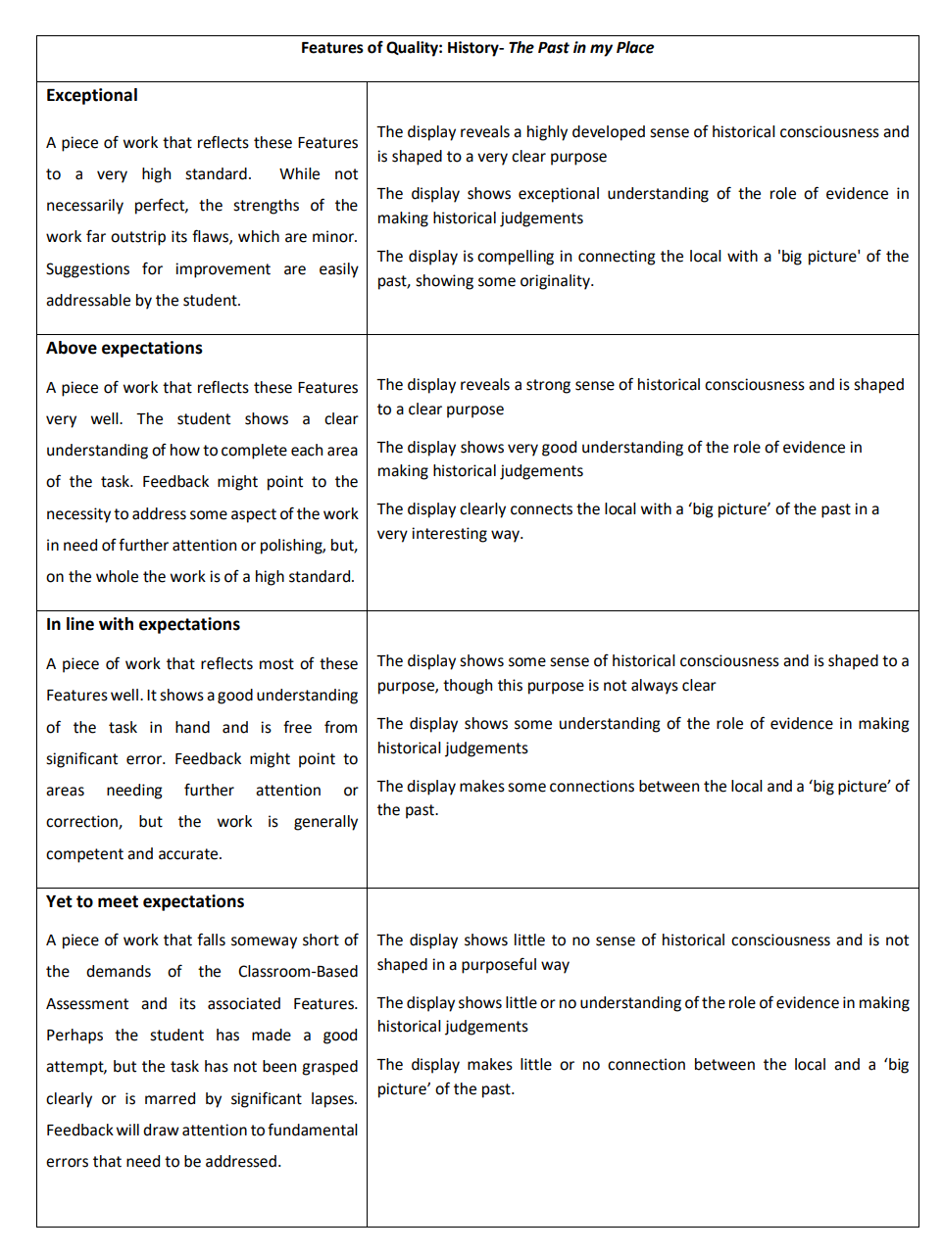

Institutional display (Possible CBA1: The past in my place)
“…there are homes all over the country who took these women and children in, all of them deserved the same investigation as the Tuam Home.”
Finbarr O’Regan, born in Clonakilty County Home, Co Cork in 1952, quoted in O’Reilly, A. 2018. My Name is Bridget. Gill: Dublin.
In small groups, as a pair or working individually, research a Mother and Baby home (or another historic institution) located in your village/town/parish/county or region.
Consider the historical significance of your chosen institution (see Assessment Guidelines, p. 10), the current state of the building/site and what, if any, plans exist to commemorate this history.
Follow the four stages of activity outlined in the Assessment Guidelines (pp.15-17), with the CBA1 Features of Quality in mind (p.19).

Slide 3
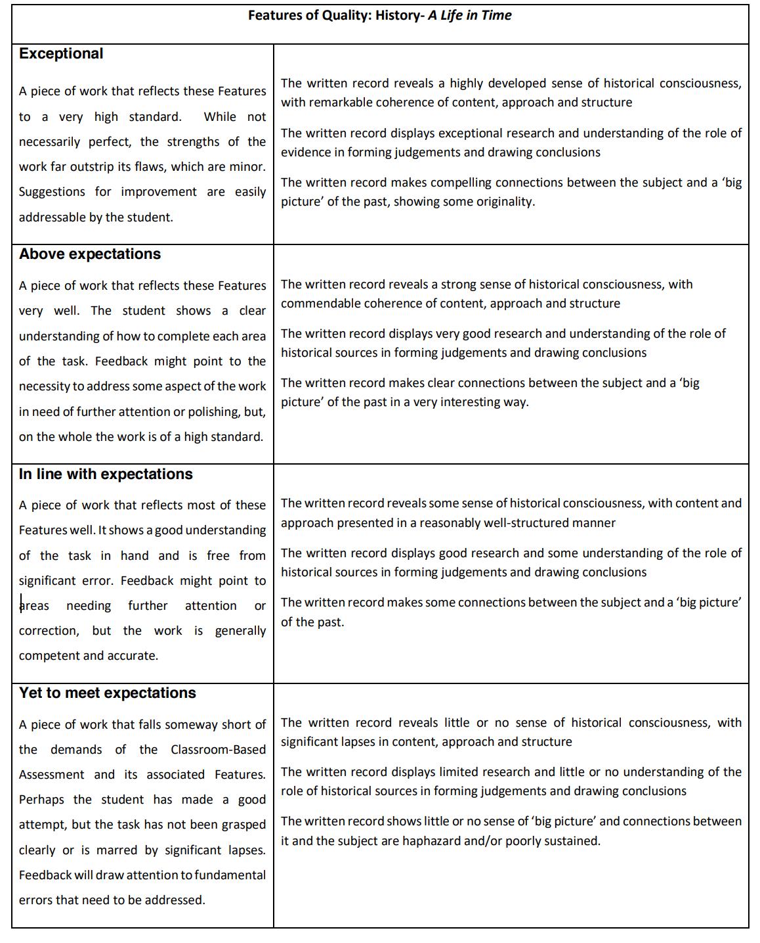
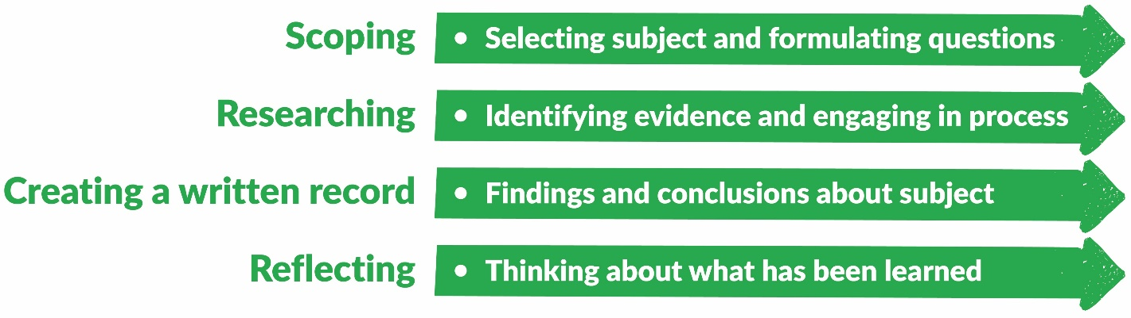
Living legacy record (Possible CBA2: A life in time)
“We are a living legacy of that system…”
Mari Steed, born in 1960 in Bessborough Mother and Baby home, and adopted to America aged 2, quoted in O’Donnell, K., O’Rourke, M. & Smith, J. eds. 2022. Redress: Ireland’s Institutions and Transitional Justice. UCD Press: Dublin.
Working individually, research and create a written record of one person with experience of a Mother and Baby home (and/or other historic institutions).
Follow the four stages of activity outlined in the Assessment Guidelines (pp.26-28), with the CBA1 Features of Quality in mind (p.29).

